Slide 1
Fake News Detection
Deepansh Malviya
ts1799

Slide 2
Introduction
Fake news is false or misleading information that can undermine trust in reliable sources and have long-term impacts on democracy and social cohesion.
The internet and social media have made it easier to spread fake news, highlighting the need for reliable tools to combat it.
Deep learning models can be used to detect fake news with high accuracy, helping to prevent the spread of false information and promote reliable sources of news and information.
In this project, we explored the use of deep learning models for fake news detection.
Our results showed that the models achieved high accuracy, precision, recall, and F1-score, outperforming a naive model.

Slide 3
About Dataset
Used the Fake News Detection dataset from University of Victoria
Two datasets: true and fake
True dataset has 21,417 observations, fake dataset has 23,481 observations
Variables: title, text, subject, date
True dataset contains articles from reputable news sources
Fake dataset contains articles from unreliable sources spreading false information

Slide 4
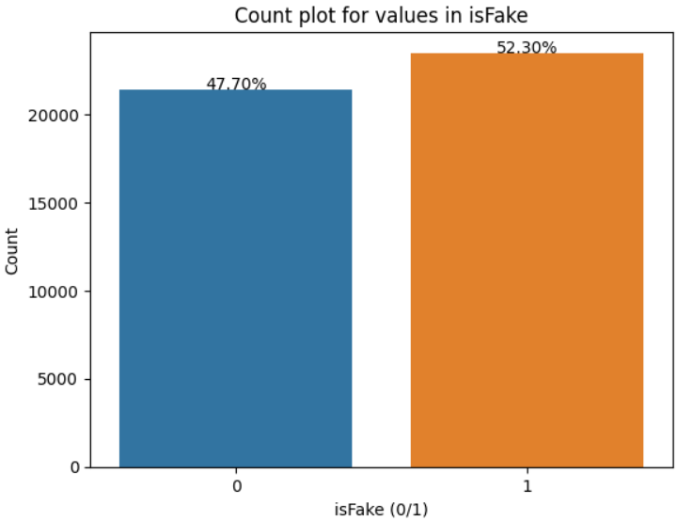
Exploratory data analysis
The target variable ‘isFake' was not present in the original datasets and was added during the preprocessing step.
The variable ‘isFake' was assigned the value ‘0' for the real news dataset and the value ‘1' for the fake news dataset.
The resulting distribution of the target variable shows that:
52.3% of the data is classified as fake news.
The remaining 47.7% is classified as real news.

Slide 5


Exploratory data analysis
Fake News Word cloud
The real news word cloud contains the name of the publisher Reuters, indicating the importance of reliable sources of information in real news.
Real news Word Cloud
The fake news word cloud does not have any source of information, highlighting the lack of credibility and authenticity in fake news.

Slide 6
Data Preprocessing
Converted all the text data to lowercase to ensure that similar words with different cases are treated as the same.
Removed all the punctuations and special characters from the text data.
Extracted publisher information from the text column.
Combined the text and title column to create a new column named article.
Added the target column isFake to the dataset.
Pre-processed dataset by removing irrelevant columns and duplicates
Combined true and fake dataset into a single dataframe
The text data was tokenized, which involves splitting the text into individual words. For this, the Tokenizer function from the keras was used.

Slide 7
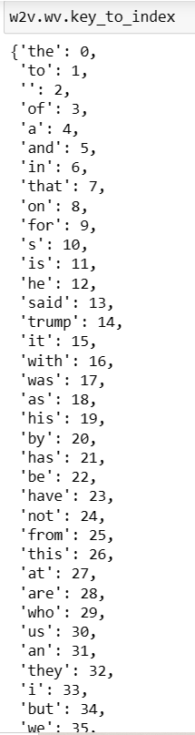
Word Embedding
Word embeddings are a way of representing words as high-dimensional vectors, allowing them to be used as inputs for machine learning algorithms.
We used the Word2Vec algorithm from the Gensim library to generate word embeddings for our text data.
Word2Vec represents each word as a dense vector in a high-dimensional space, with each dimension representing a different aspect of the word's meaning.
The vectors are learned by predicting the context in which a word appears in a given sentence.
Once the word embeddings are generated, they can be used as inputs for machine learning algorithms to perform tasks such as classification or clustering.

Slide 8
Naïve model
The naive model predicts the majority class as the output for every sample.
In the case of binary classification, this means predicting the class that occurs more frequently in the training set.
This model does not learn any patterns or relationships between the features and the target variable, and simply makes the most common prediction.
The performance of this model can be used as a baseline to compare the performance of more sophisticated models.
Accuracy for the naïve model is : 0.5229

Slide 9
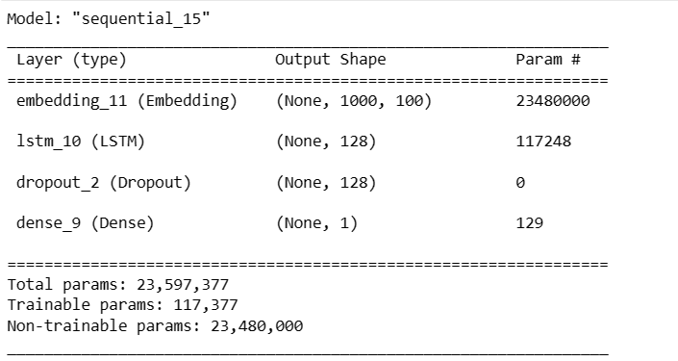
Model Architecture
The model is a sequential neural network that takes in sequences of words.
The first layer is an embedding layer that converts each word in the input sequence into a dense vector of fixed size (output_dim=DIM).
The weights for the embedding layer are pre-trained using a Word2Vec model and passed to the layer (weights=[embeddingVectors]).
The input length for the layer is set to 1000 (input_length=1000).

Slide 10
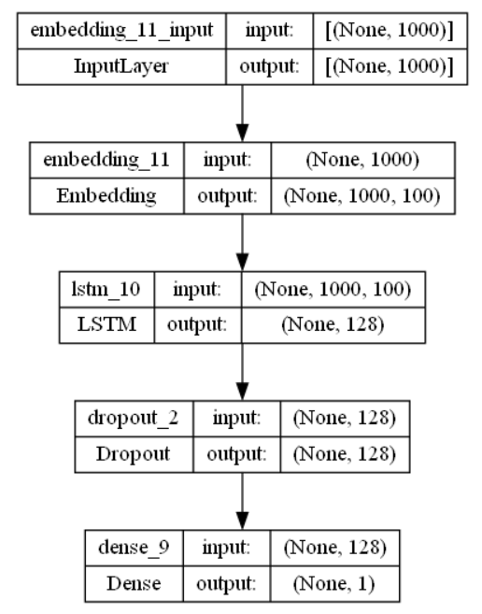
Model Architecture
The embedding layer is set to be untrainable (trainable=False) so that the pre-trained weights are not updated during training.
The second layer is an LSTM layer with 128 units, which is used to capture the sequential information in the input sequence.
The third layer is a dropout layer with a rate of 0.5, which helps prevent overfitting by randomly dropping out some of the units during training.
The final layer is a dense layer with one unit and sigmoid activation function, which is used for binary classification (outputting a probability between 0 and 1).

Slide 11
Training and Validation
Used Adam optimizer for efficient stochastic gradient descent algorithm
Binary_crossentropy was the loss function for binary classification problem
Accuracy was used as evaluation metric
Models were validated using a train-test split with an 80:20 ratio to evaluate their performance on unseen data.
Regularization techniques, such as L2 regularization and dropout, are used to reduce overfitting.

Slide 12
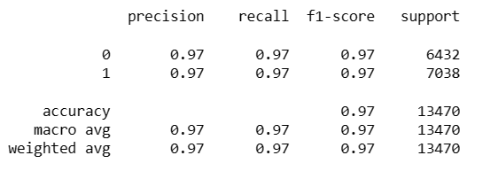
Result
The deep learning models achieved high accuracy, precision, recall, and F1-score compared to a naive baseline model. The performance of the models was as follows:
Accuracy of the deep learning model is: 0.9725
In comparison, the naive model had the following performance:

Slide 13
Conclusion
Developed deep learning models achieved high accuracy and F1-score on validation set.
Results demonstrate the potential of using deep learning for fake news detection.
High-quality datasets are crucial for training such models.
Deep learning models can help combat online misinformation and disinformation.
Can be used with other techniques like NLP and network analysis to develop more comprehensive detection systems.
Future work could explore different architectures and techniques like transformers, attention mechanisms, adversarial training, transfer learning, and ensembling to further improve performance.

